Slide 1
Basic Views

Slide 2
Using Selection Widgets
Selection views – widgets for presenting lists of choices – are handed an adapter to supply the actual choices
Difference between clicks and selections
Widgets based off of the "spinner" paradigm – including Spinner and Gallery – treat everything as selection events.
Other widgets – like ListView and GridView – treat selection events and click events differently
Notes:
You’ve already done that with ListViews

Slide 3
Using Selection Widgets
Selection events are driven by the pointing device, such as using arrow keys to move a highlight bar up and down a list
Click events are when the user either "clicks" the pointing device or taps on something in the widget using the touchscreen.

Slide 4
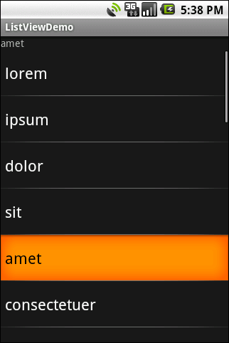
ListView
ListViews often use the entire UI to create the selected list and can be scrolled down if the list is too large.

Slide 5
ListView
To use a ListView (the tough way):
Have your MainActivity class extend from the ListActivity rather than the Activity class.
This provides a built-in XML file that contains a ListView widget, properly anchored on the page.
That way you do not need to create an XML file with a ListView since the ListActivity has a ListView included by default.
You can thus remove the call to setContentView(…)

Slide 6
ListView
In the onCreate() method, use the setListAdapter() method to programmatically fill the entire screen of the activity with a ListView
The ArrayAdapter object manages the array of strings that will be displayed by the ListView
The onListItemClick() method is fired whenever an item in the ListView has been clicked

Slide 7
Using a custom xml file for ListView
A ListView may use a custom xml file to change the look of the list
In this case since the main XML file is not needed, you can rename it and use it for your ListView XML file
Can use any (simple) xml file to be used as a ListView style

Slide 8
Selection Modes
By default, ListView is set up simply to collect clicks on list entries
Sometimes, though, you want a list that tracks a user's selection, or possibly multiple selections
ListView can handle that as well, but it requires a few changes

Slide 9
Selection Modes
First, need to call setChoiceMode() on the ListView in Java code to
set the choice mode, supplying either CHOICE_MODE_SINGLE or CHOICE_MODE_MULTIPLE as the value.
Can also declare this via the android:choiceMode attribute in your layout XML

Slide 10
Selection Modes
Then, rather than use android.R.layout.simple_list_item_1 as the layout for the list rows in your ArrayAdapter constructor, need to use either
android.R.layout.simple_list_item_single_choice - or -
android.R.layout.simple_list_item_multiple_choice
for single-choice or multiple-choice lists, respectively

Slide 11
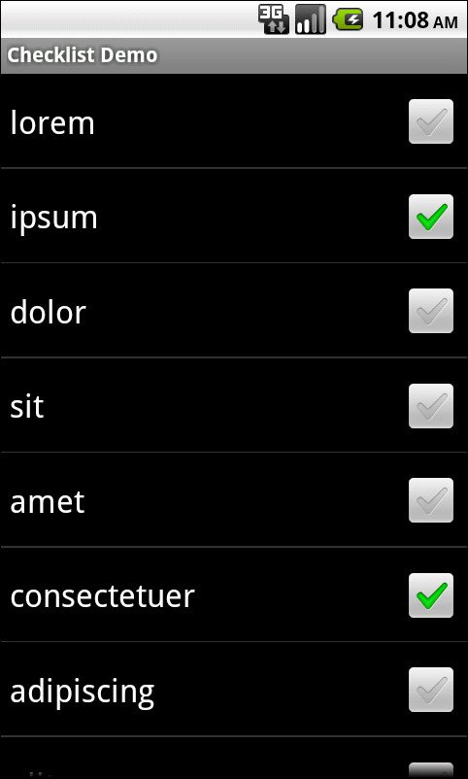
Example

Slide 12
ListView
Use the listView.setTextFilterEnabled(true) to allow the user to type at the keypad and have the ListView automatically filter to match what you have typed.
Use the listView.setItemChecked() method to display the check icon next to each item.
We could call methods like getCheckedItemPositions() on our ListView to find out which items the user checked.

Slide 13
Clicks versus Selections
If the user clicks a row in a ListView, a click event is registered, triggering onListItemClick() in an OnItemClickListener
If the user uses a pointing device to change a selection that triggers selection events such as onItemSelected() in an OnItemSelectedListener
Many times, particularly if the ListView is the entire UI at present, it only care about clicks

Slide 14
Spin Control
The Spinner is the equivalent of the drop-down selector you might find in other toolkits
Have the ability to select from a list without taking up all the screen space of a ListView, at the cost of an extra click or screen tap to make a change
To use a Spinner, provide the adapter for data and child views via setAdapter() and hook in a listener object for selections via setOnItemSelectedListener()

Slide 15

Spin Control
To tailor the view used when displaying the drop-down perspective, you need to configure the adapter, not the Spinner widget.
Use the setDropDownViewResource() method to supply the resource ID of the view to use.
This is the XML code for a spinner:

Slide 16
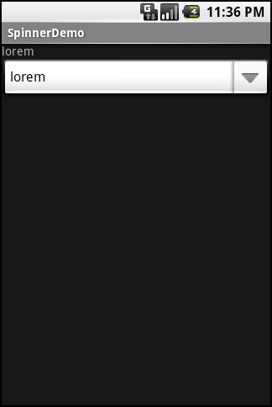
Spin Control
To use the Spinner use a selection listener as Spinner widgets only support selection events, not click events

Slide 17
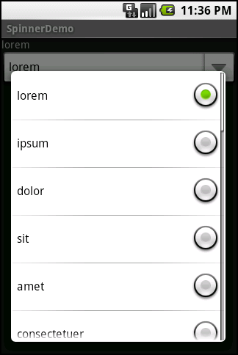
Spin Control
This is a view of the Spinner control with the drop-down list displayed.

Slide 18
Accessing Spinner
Because the Spinner control is not a TextView, but a list of TextView objects, you cannot directly request the selected text from it
In order to get the text value that has been chosen in a Spinner, first retrieve the selected View and then extract the text directly from it:
final Spinner spin = (Spinner) findViewById(R.id.Spinner01);
TextView text_sel = (TextView)spin.getSelectedView();
String selected_text = text_sel.getText();

Slide 19
GridView
GridView contains a Grid of view items, with a specific number of columns
Often used with image icons
Some control over the number and size of the columns
The number of rows is dynamically determined based on the number of items the supplied adapter says are available for viewing
Like the ListView, this is a type of AdapterView control and thus can use the ArrayAdapter to fill itself

Slide 20
GridView
There are a few properties which, when combined, determine the number of columns and their sizes:
android:numColumns spells out how many columns there are, or, value of auto_fit, to compute the number of columns based on available space and the following properties
android:verticalSpacing and android:horizontalSpacing indicate how much whitespace there should be between items in the grid.
android:columnWidth indicates how width of each column
android:stretchMode indicates, for grids with auto_fit where the extra space should go
columnWidth to have the columns take up available space or spacingWidth to have the whitespace between columns absorb extra space.

Slide 21
GridView
Otherwise, the GridView works much like any other selection widget – use setAdapter() to provide the data and child views, invoke setOnItemSelectedListener() to register a selection listener, etc.

Slide 22
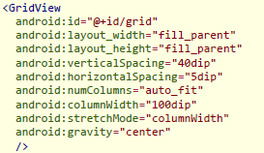
GridView
For example, here is an XML layout from the Selection/Grid sample project, showing a GridView configuration:

Slide 23
GridView
This grid takes up the entire screen except for what the selection label requires.
The number of columns is computed by Android (android:numColumns = "auto_fit") based on our horizontal spacing (android:horizontalSpacing = "5dip") and columns width (android:columnWidth = "100dip"), with the columns absorbing any "slop“ width left over (android:stretchMode = "columnWidth").

Slide 24
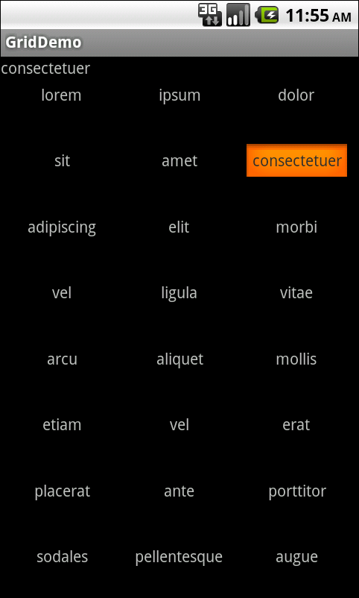
GridView
With the vertical spacing from the XML layout (android:verticalSpacing = "40dip"), the grid overflows screen boundaries
GridView, like ListView, supports both click events and selection events.

Slide 25
AutoCompleteTextView
The AutoCompleteTextView is sort of a hybrid between the EditText (field) and the Spinner.
With auto-completion, as the user types, the text is treated as a prefix filter, comparing the entered text as a prefix against a list of candidates.
Matches are shown in a selection list that folds down from the field.
The user can either type an entry (e.g., something not in the list) or choose an entry from the list to be the value of the field.

Slide 26
AutoCompleteTextView
AutoCompleteTextView subclasses EditText, so you can configure all the standard look-and-feel aspects, such as font face and color.
In addition, AutoCompleteTextView has a android:completionThreshold property, to indicate the minimum number of characters a user must enter before the list filtering begins.

Slide 27
AutoCompleteTextView
You can give AutoCompleteTextView an adapter containing the list of candidate values via setAdapter().
However, since the user could type something not in the list, AutoCompleteTextView does not support selection listeners.
Instead, you can register a TextWatcher, like you can with any EditText, to be notified when the text changes.
These events will occur either because of manual typing or from a selection from the drop-down list.

Slide 28
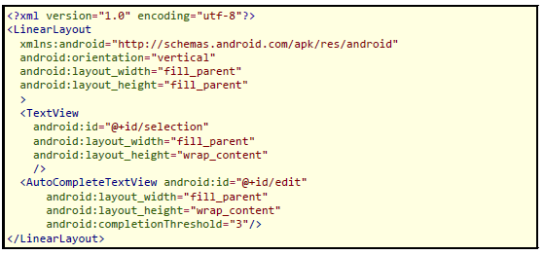
AutoCompleteTextView
Below we have an XML layout, this time containing an AutoCompleteTextView:

Slide 29
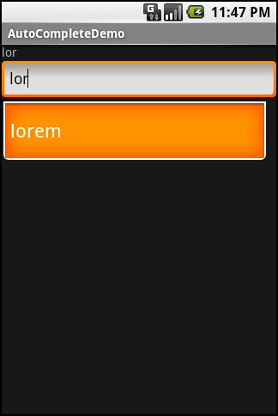
AutoCompleteTextView

Slide 30
Using the Views
The following three steps are necessary to set up and use any of the above three Views:
Create and fill an ArrayAdapter with the view objects to be displayed
Use the SetAdapter() method to create the View and bind the data to it
Call setOnItemClickListener() on your AdapterView and pass it an implementation of the AdapterView.OnItemClickListener class

